Slide 1
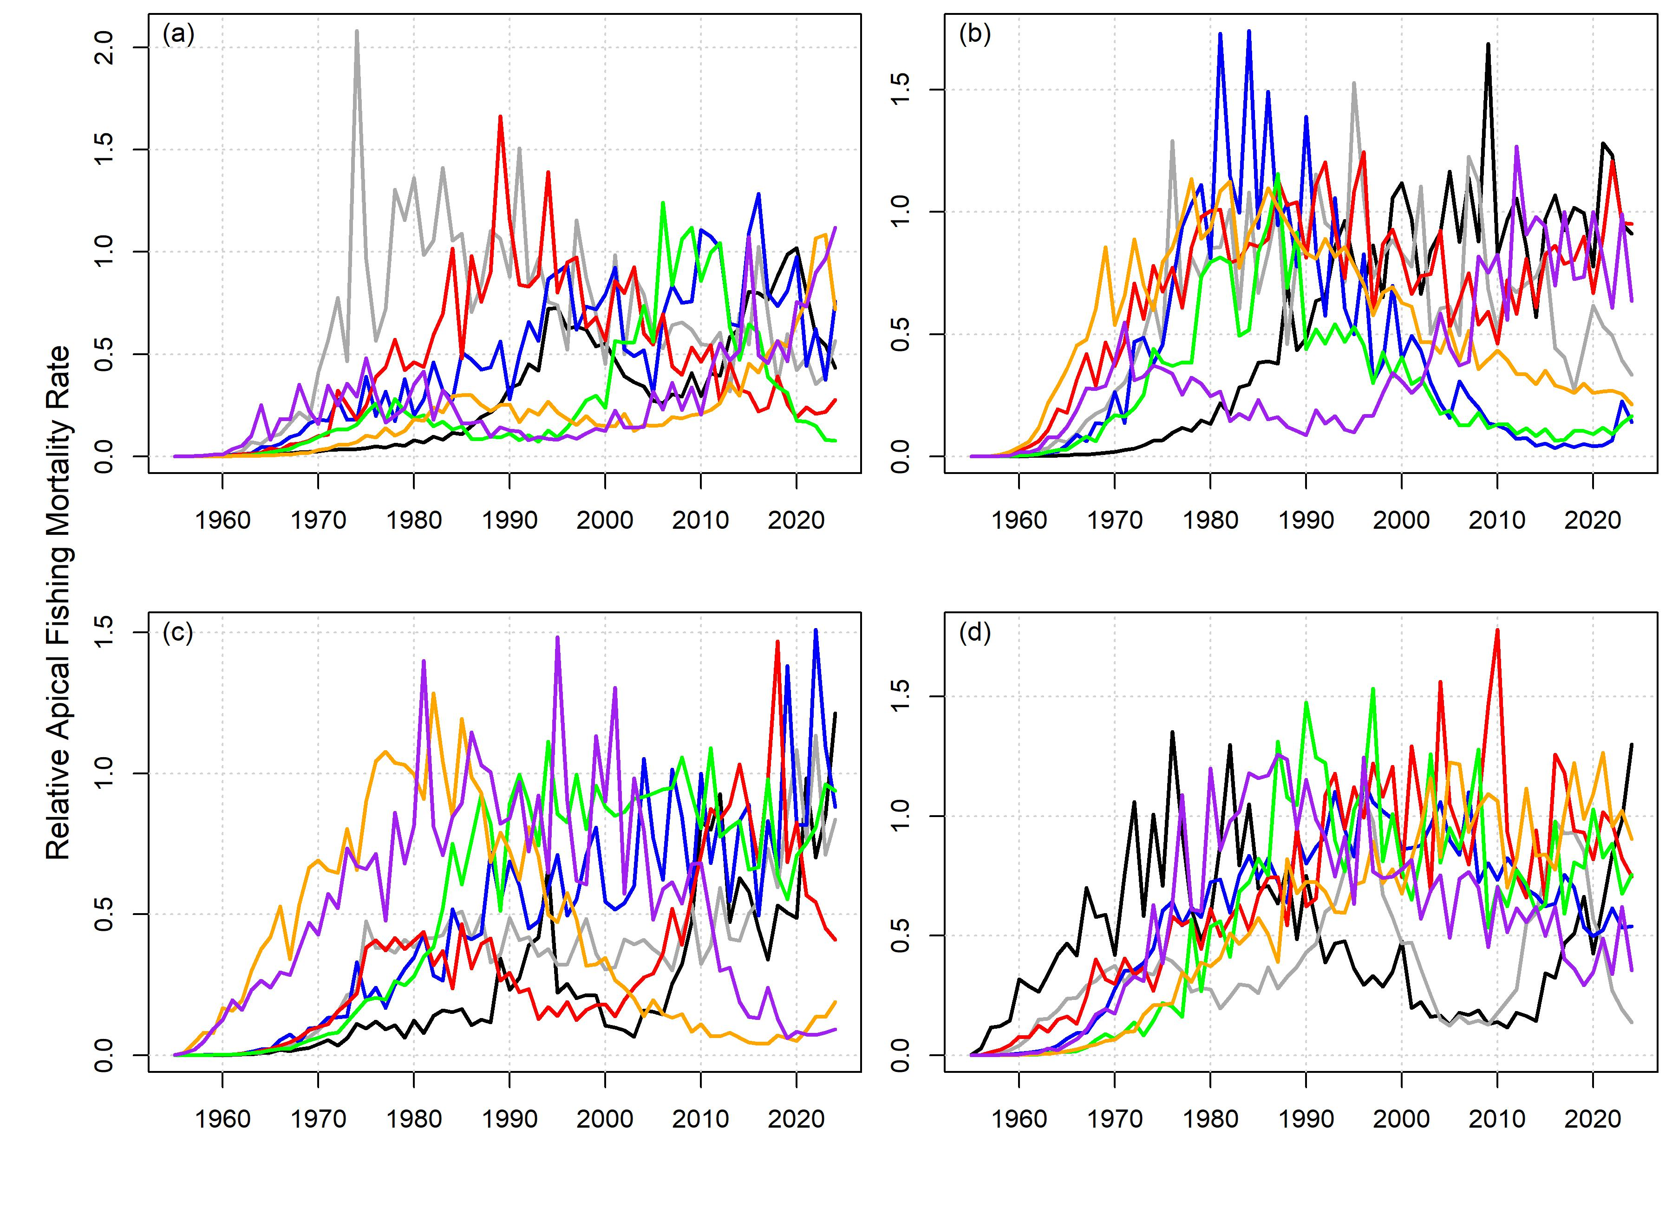
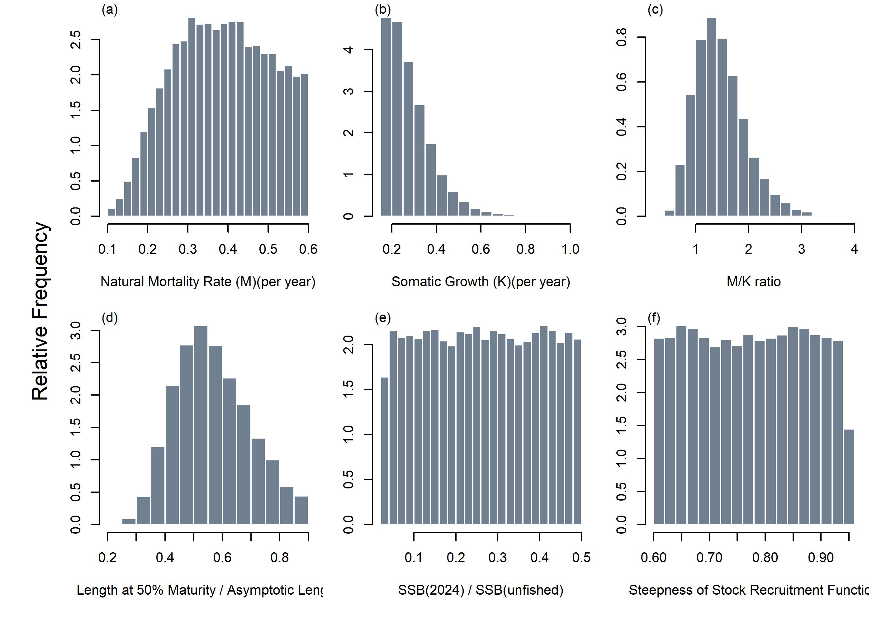
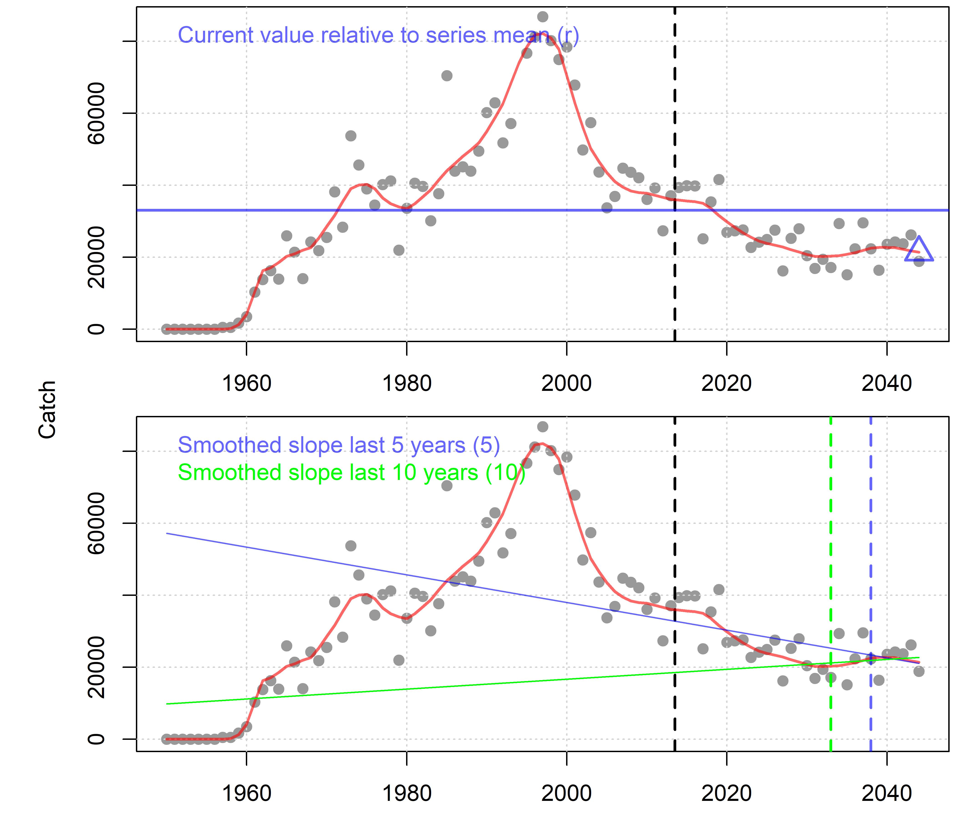
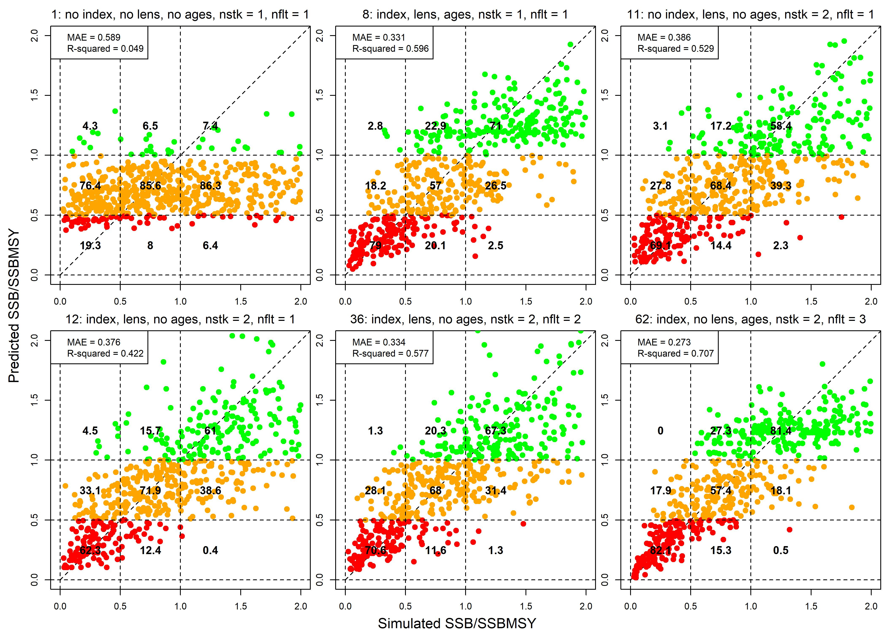


EcoTest Indicator 2: A General-Purpose Stock Status Indicator for Sharks, Billfish and Tunas
Tom Carruthers & Nathan Taylor
SCRS/2025/109
12th March 2025, ICCAT SC-ECO

Slide 2
Contents
The EcoTest framework
Quick recap on Indicator I
Indicator 2: a wider simulation
Data streams and quantities
Neural networks
Predictive ability
Next steps

Slide 3
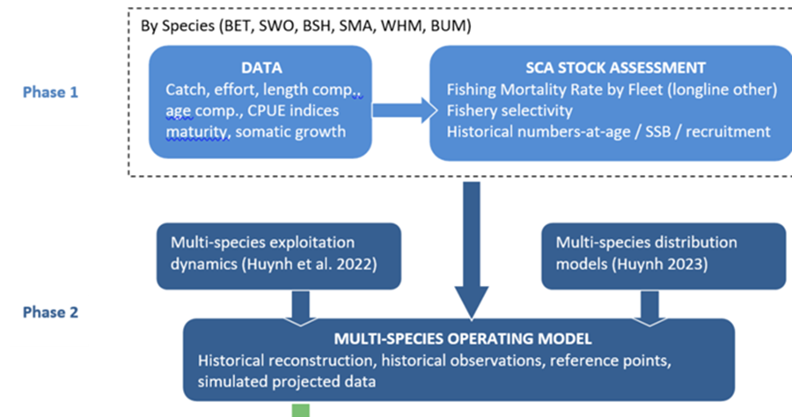
1. The EcoTest Framework
Huynh et al. SCRS/2022/106

Slide 4
1. The EcoTest Framework
Huynh et al. SCRS/2022/106

Slide 5
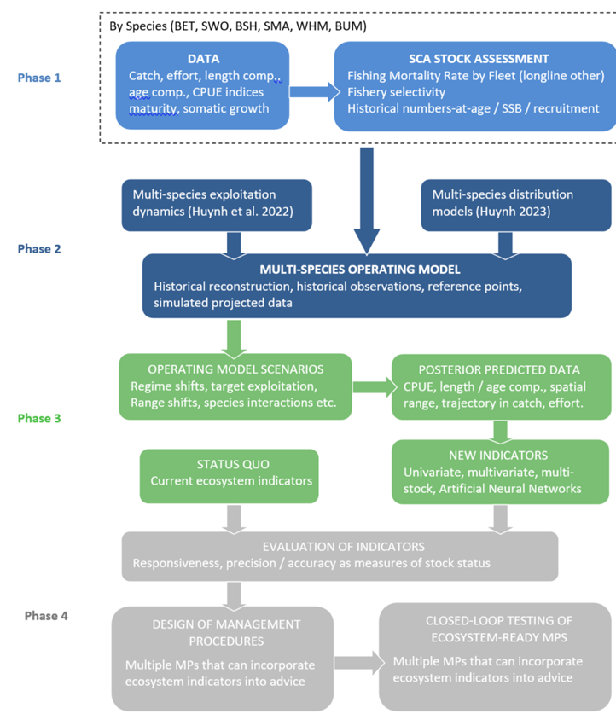
1. The EcoTest Framework

Slide 6
1. The EcoTest Framework

Slide 7
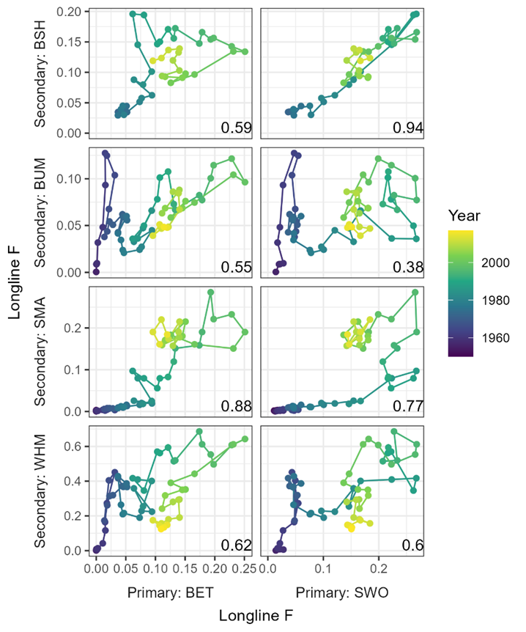
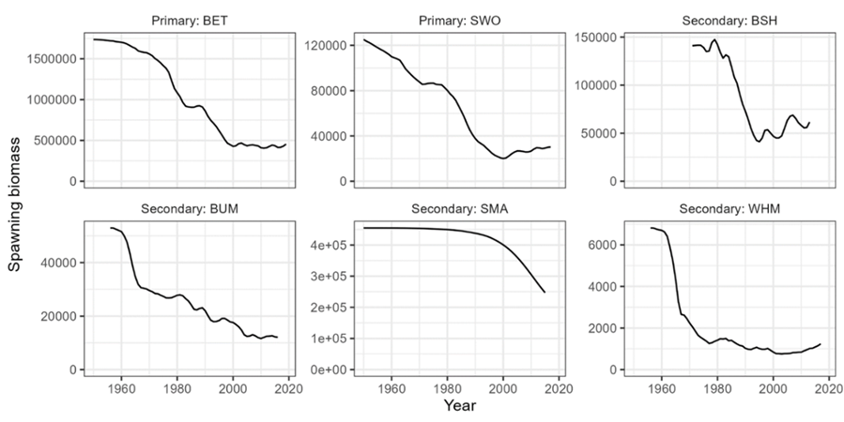
2. Recap of Indicator 1 for the North Atlantic Longline Case study
Phases I and II:

Slide 8
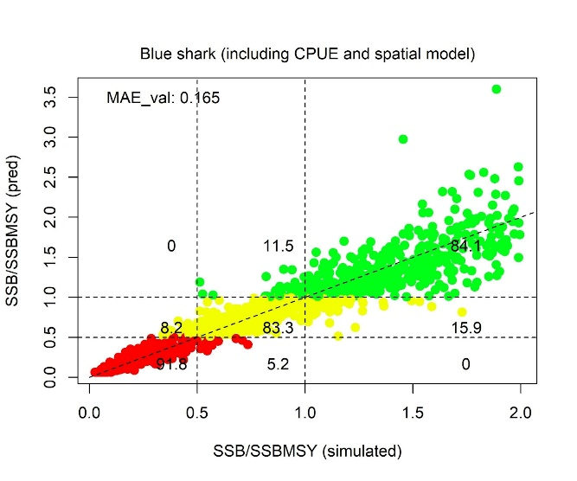
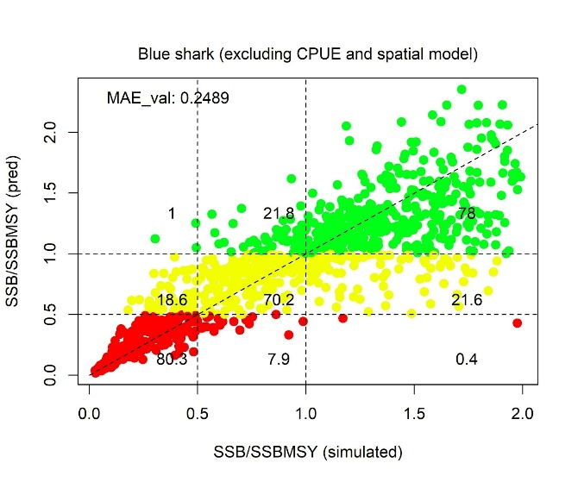
2. Recap of Indicator 1 for the North Atlantic Longline Case study: phase III
Predictive performance of a neural network fitted to true blue shark stock status (SSB / SSBMSY) using all data inputs (left panel) and all data inputs except CPUE time series and the spatial model (right panel). The plotted data are for a completely independent testing dataset of 1000 data points. The mean absolute error of the validation dataset is included in the top left of each panel. Plotted points are color coded according to the predicted categorical stock status defined by the horizontal lines at 0.5 and 1.0 SSB / SSBMSY.

Slide 9
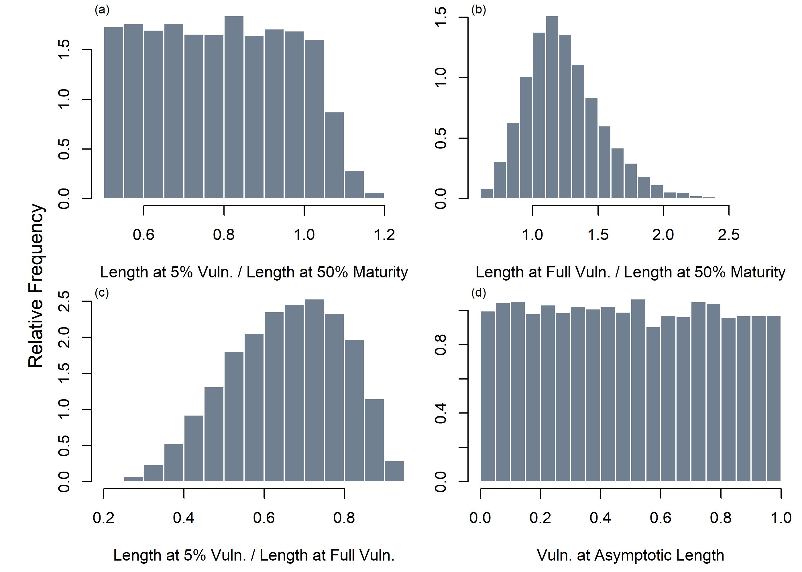
3. Indicator 2: a wider simulation
A much wider range of exploitation histories with varying selectivity dynamics
Relative Fishing Mortality Rate
Much wider range of life-history parameters sampled from the families Istiophoridae (marlins), Scombridae (mackerels, tunas and bonitos) and Carcharhinidae (requiem sharks).
100,000 simulations of a multi-stock (3) and multi-fleet (3) fishery.

Slide 10
4. Data streams and quantities: Time series data
Example time series data types:
Catch
Catch ratios (species x / species y)
Nominal CPUE
Mean length in catch
Variance of lengths in catch
Fraction mature in catch
Derived quantities for each data type:
Current level relative to series mean (r)
Slope over last 5 years
Slope over last 10 years
Slope over last 20 years
Residual error (around smoothed trend)
Observations
Loess smoother

Slide 11
4. Data streams and quantities: species-specific life-history / fishery quantities
Life history:
M/K ratio
Maximum age (age to 1% survival)
Length at 50% maturity (L50) relative to asymptotic length (Linf)
Selectivity
Length at first capture relative to L50
Length at full capture relative to L50
Selectivity at asymptotic length
Coupled with the time-series quantities there are up to 540 possible data inputs to an indicator of a single species stock status (for example).

Slide 12
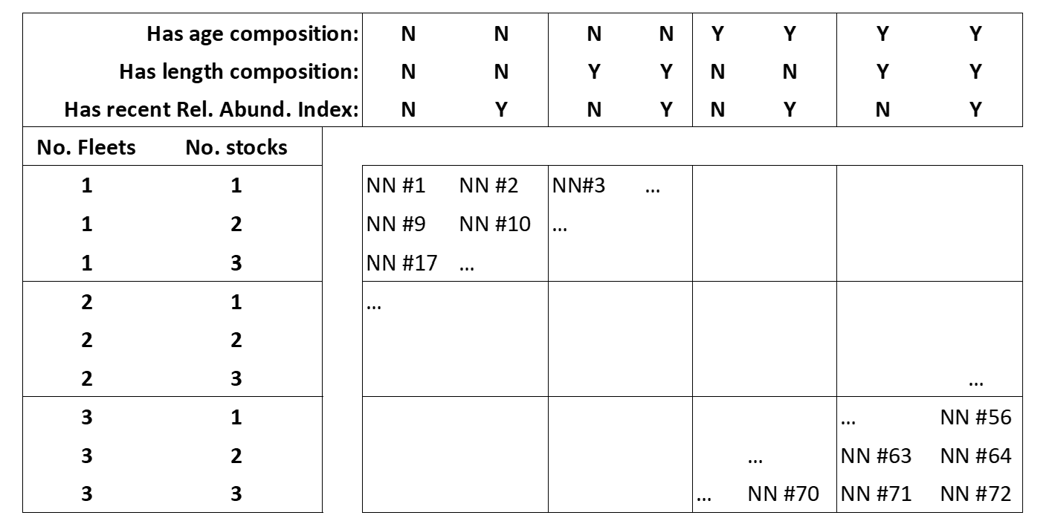
5. Neural networks of Indicator 2

Slide 13
6. Predictive ability
Zero to good predictive ability depending on the number of data streams, stock and fleets
Work to be done on optimizing neural network design for the input data available.

Slide 14
7. Next steps (Phase IV)
Package Indicator 1 and 2 into a documented R package for use as a stock status indicators.
Conduct robustness testing to time varying dynamics such as changing somatic growth, recruitment and natural mortality.
Test indicators against stock assessments using those data.
Develop management procedures that use the indicators to modify management advice for secondary species.
Conduct a workshop.

Slide 15
Acknowledgements
EcoTest is funded by ICCAT as part of a commitment to the Global Environmental Facility (GEF) Common Oceans ABNJ Tuna Project Fund.
Many thanks to The Ocean Foundation for funding Phases I and II of the EcoTest framework.
Thanks to Alex Hanke, Sachiko Tsuji, Guillermo Diaz, Diego Alvarez, Laurie Kell, Maria Juan Jorda, Andres Domingo for their helpful comments on Indicator 1.

